Slide 1
Properties of secure software
Confidentiality
Integrity
Availability
Non-repudiation
Authentication

Slide 2

Confidentiality
The ability of a system to ensure that an asset is viewed only by authorized parties
Sensitive information is not leaked to unauthorized parties
Privacy for individuals, confidentiality for data
Examples
Confidentiality: exam assignments should not be published (at least not until the exam is over)
Privacy: grades should only be visible to instructor and student involved

Slide 3

Integrity
The ability of a system to ensure that an asset is modified only by authorized parties
Sensitive information is not damaged by unauthorized parties
Examples
Submissions are not edited by anyone other than student
Submissions are not edited by anyone after the deadline
Grades are determined only by instructor or auto-grader
Assignments, submissions, grades are not removed / only by instructor

Slide 4

Availability
The ability of a system to ensure that an asset can be used by any authorized parties
A system is responsive to requests
Example
Should execute program tests fast (in reasonable time)
Should be responsive when editing text/code

Slide 5
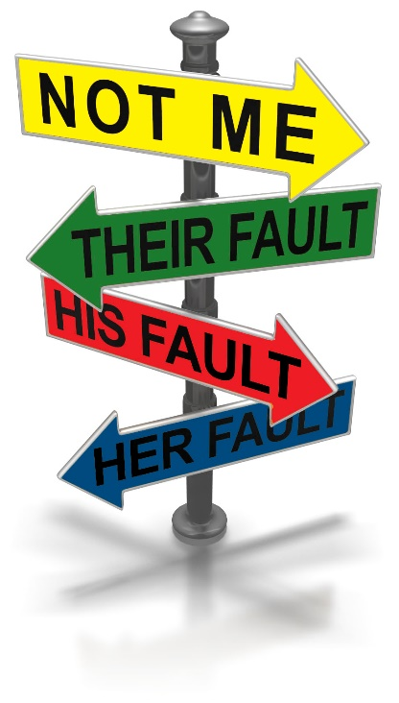
Nonrepudiation (accountability)
The ability of a system to confirm that a sender cannot convincingly deny having sent something
Note: opposite of privacy/anonymity; requires a balance
Examples
Student cannot deny to have edited submission after the deadline

Slide 6

Authentication
The ability to verify the identity of an individual or entity.
Verify the identity of a person (or other external agent) making a request of a computer system
Example
Should be able to determine if the user is indeed a student or an instructor

Slide 7
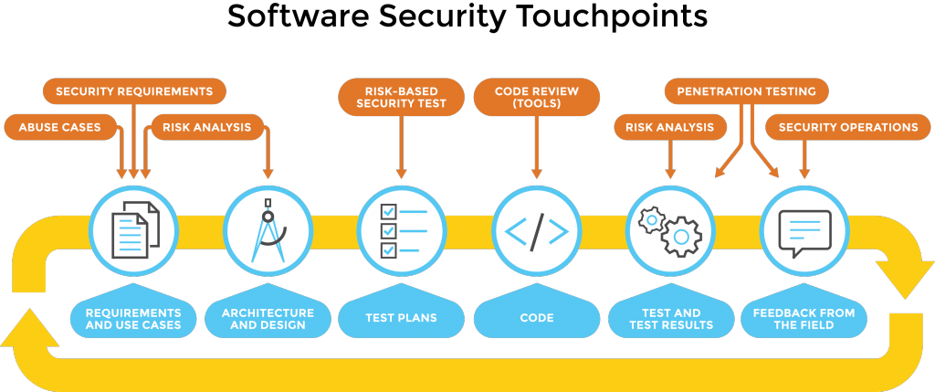
Secure Software Development Life Cycle (SSDLC)

Slide 8
Core principles
Identification: “is how a user tells a system who he or she is (for example, by using a username or User ID);
Authentication: “is the process of verifying a user's claimed identity (for example, by comparing an entered password to the password stored on a system for a given username).”;
Authorization: “defines a user's rights and permissions on a system. After a user (or process) is authenticated, authorization determines what that user can do on the system.”;
Auditing: “an evaluation of an organization, system, process, project or product”.

Slide 9
Excuses from practitioners
“No one will do that!”
“Why would anyone do that?”
“We've never been attacked.”
“We're secure, we use cryptography.”
“We're secure, we use ACLs.”
“We're secure, we use a firewall.”

Slide 10
More excuses
“We've reviewed the code, and there are no security bugs.”
“We know it's the default, but the administrator can turn it off.”
“If we don't run as administrator, stuff breaks.”
“But we'll slip the schedule.”
“It's not exploitable.”
“But that's the way we've always done it.”
“If only we had better tools….”

Slide 11
Good and Bad Practices

Slide 12
Good practices: Input validation
Fields length and buffers bound checking
Validate input not only on client-side but on server-side environment too;
Use “preparedStatement()” in Java and similar functions in other languages to avoid SQL Injection attacks;
Possibly use high level virtualized languages such Java, C#;
Low level languages like C and C++ are more exposed to buffer overflow exploits;

Slide 13
Good practices: Confidentiality
Use Public Key Cryptography to do effective encryption;
Encrypt and sign passwords with PGP, GnuPG, RSA or other encryption tools; store them in a secure place;
Zero memory stored passwords after the use;
Use a well known encryption algorithm: security is granted by the key and the well-known algorithm;
Use well known secure protocols to implement channel encryption;
Create secure temporary files;

Slide 14
Good practices: Integrity
Use strength passwords but not too complex: every password must be at least eight characters length (upper and lower case, number and special characters); passwords haven't to be too complex to avoid user writing down passwords everywhere!
Identification & Authentication have to be done over encrypted channels;
Adopt well known access control policy: DAC, MAC or RBAC;
Do not use applets or ActiveX in Web application: user could be constrained to activate ActiveX or Applet execution in the Web Browser exposing the browser to malicious components.

Slide 15
Good practices: Activities
Documenting security policies adopted by your software;
Plan periodic independent reviews;
Use Checklists to do security tests;
Comment your code, this can help the security reviewer and tester;

Slide 16
Bad practices
Write passwords everywhere or say them to everyone:
Social Engineering is very diffuse; memorize your passwords or encrypt them;
Create administration backdoor in your applications:
create an “administrator” user with high privileges instead;
“Security through obscurity”:
use well known security algorithm and secure keys;
“Retrofit” security:
secure your software with SSDLC;

Slide 17
More bad practices
Think that software security is network security!
Many security problems become from OS C/C++ programming buffer overflow problems:
Think that third party software is secure:
it isn't true, check them;
Think that random functions are true Random!:
Random is only in nature; in a computer world all functions are pseudorandom;
“Hard-code” password in your software:
use asymmetric cryptography;
Don't check “cut & paste” code:
analyse the code first!
Think that attackers come from the outside:
Most attack activities are inside in the enterprise;

